Slide 1
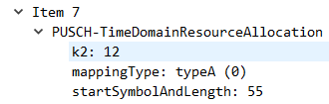
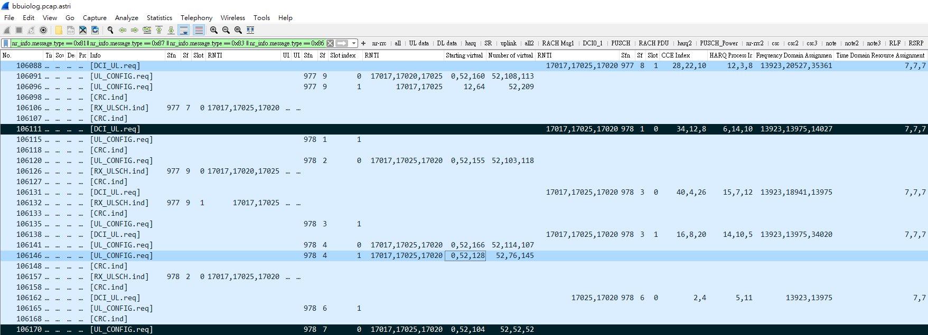
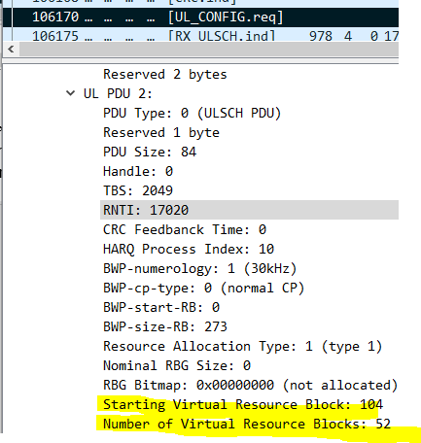
(978,1,0) 7 k2=12 => 2+12=14 =>(978,14)=>(978,7,0)
[DCI_UL.req] (978,1,0) C-RNTI=17020 帶 DCI0_1 打在DL Slot，攜帶
Frequency Domain Resource Assignment: 14027 =>這是RIV，反求https://dustinchen26.github.io/RIV/ => RB_start = 104 L_RBs = 52
Time Domain Resource Assignment: 7 =>查看RRC reconfiguration 的 Item 7 數值 k2: 12 => 也就是目前 (978,1,0)+12=(978,14)=(978,7,0)是要打uplink的地方
接著查看[UL_CONFIG.req]在(978,7,0)去收PUSCH uplink data是不是Starting Virtual Resource Block: 104 / Number of Virtual Resource Blocks: 52
(977,8,1) 7 k2=12 => 17+12=29 =>(978,9) =>(978,4,1)
N_size_BWP: 273 RIV: 13923 Calculate RB_start = 0 L_RBs = 52
N_size_BWP: 273 RIV: 20527 Calculate RB_start = 52 L_RBs = 76
N_size_BWP: 273 RIV: 35361 Calculate RB_start = 128 L_RBs = 145
(978,1,0) 7 k2=12 => 2+12=14 =>(978,14)=>(978,7,0)
N_size_BWP: 273 RIV: 13923 Calculate RB_start = 0 L_RBs = 52
N_size_BWP: 273 RIV: 13975 Calculate RB_start = 52 L_RBs = 52
N_size_BWP: 273 RIV: 14027 Calculate RB_start = 104 L_RBs = 52
Notes:
(977,1,0) 7 k2=12 => 2+12=14 =>(977,14)
(977,3,0) 7 k2=12 => 6+12=18 =>(977,18)
(977,6,0) 7 k2=12 => 12+12=24 =>(978,4)
(977,8,0) 7 k2=12 => 16+12=28 =>(978,8)
(977,8,1) 7 k2=12 => 17+12=29 =>(978,9)
(978,1,0) 7 k2=12 => 2+12=14 =>(978,14)=>(978,7,0)
N_size_BWP: 273 RIV: 13923 Calculate RB_start = 0 L_RBs = 52
N_size_BWP: 273 RIV: 13975 Calculate RB_start = 52 L_RBs = 52
N_size_BWP: 273 RIV: 14027 Calculate RB_start = 104 L_RBs = 52
setup: 8 items
Item 0
k2: 4
Item 1
k2: 5
Item 2
k2: 6
Item 3
k2: 7
Item 4
k2: 8
Item 5
k2: 9
Item 6
k2: 11
Item 7
k2: 12

Slide 2
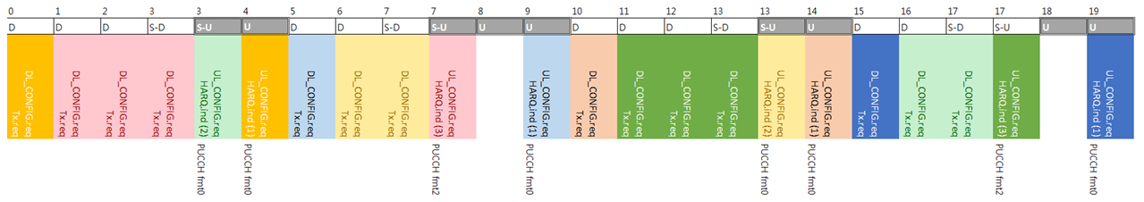
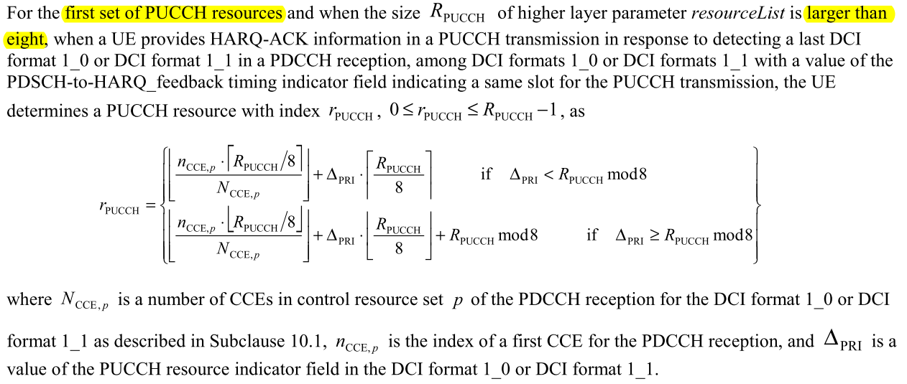
有個DCI_1_1參數PUCCH resource indicator, 當PUCCH resource set 0超過8個時, UE真實使用的PUCCH resource id必須以此為參數計算, 即TS 38.213, 9.2.3所提
Ex: log-20230619-140315_bler10_gnb_15
// DDDSU DDSUU

Slide 3
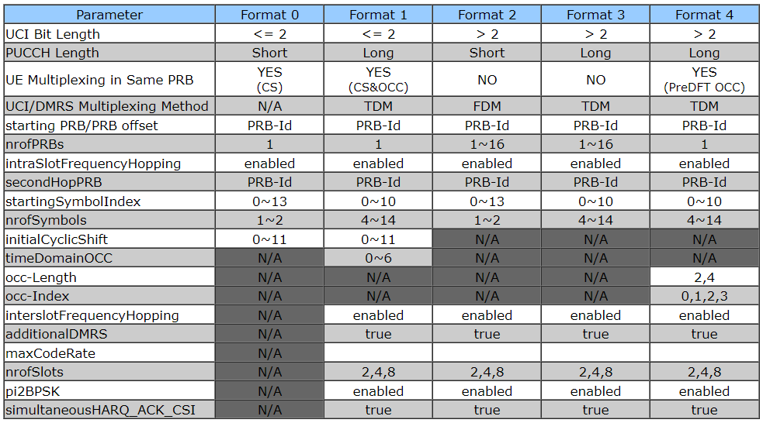
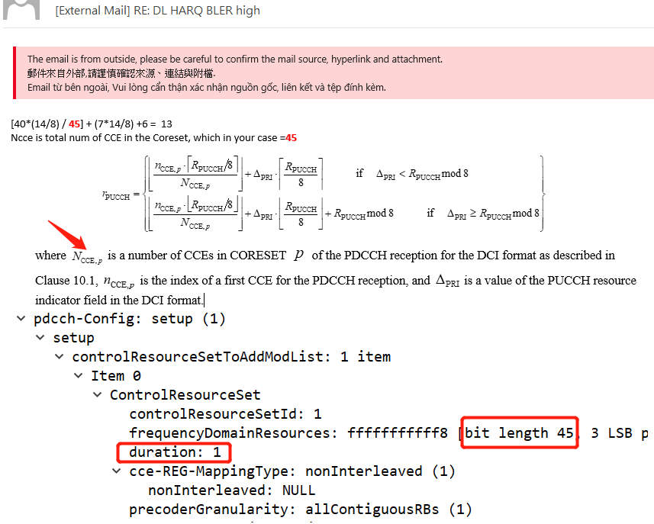
(注意1) PUCCH format 0最多2 bits，所以如果要回3 ACK/NACK bits需要format2
(注意2) DCI1_0 和 DCI1_1 由 Downlink Assignment Index (DAI) 告訴UE要回幾個ACK/NACK bits
(Note) DAI 跟 TDD pattern 有關，DDDSU最多3個D所以DAI=0,1,2
(注意3) 這個公式是使用在PUCCH resource set 0超過8個
=> 由 DCI1_1 的 PUCCH, 計算回 ACK 的 PUCCH index, 檢查 StartingPRB
=> 有個DCI_1_1參數PUCCH resource indicator, 當PUCCH resource set 0超過8個時, UE真實使用的PUCCH resource id必須以此為參數計算, 即TS 38.213, 9.2.3所提

Slide 4
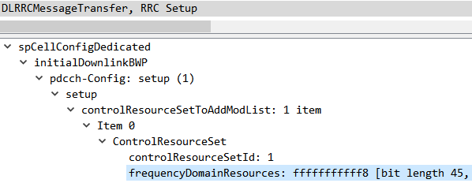
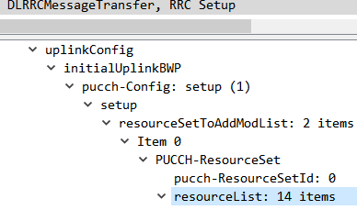
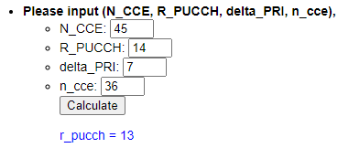
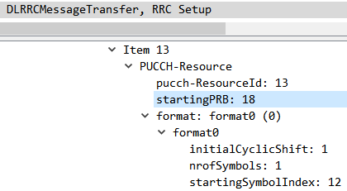
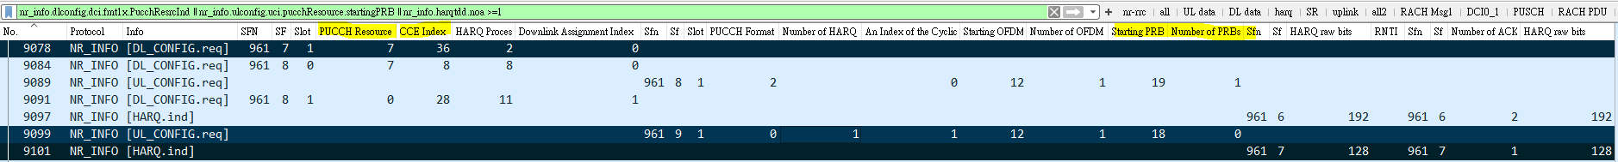
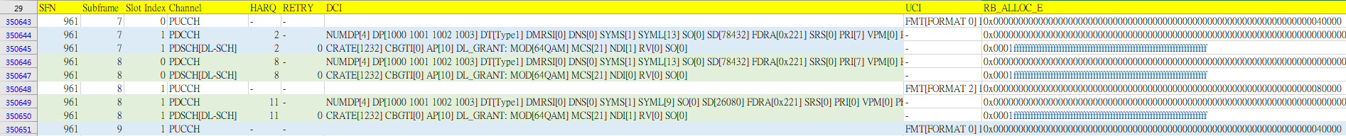
nr_info.dlconfig.dci.fmt1x.PucchResrcInd || nr_info.ulconfig.uci.pucchResource.startingPRB || nr_info.harqtdd.noa >=1
0x40000
= 0100 0000 0000 0000 0000
= startingPRB: 18
Notes:
0x40000 = 0100 0000 0000 0000 0000 = startingPRB: 18
"""
38.213 chap 9.2.3 UE procedure for reporting HARQ-ACK
ex:
// rantcp RRC Setup => N_CCE=45
330 F1AP/NR RRC SACK (Ack=4, Arwnd=352516352) , DLRRCMessageTransfer, RRC Setup
controlResourceSetToAddModList: 1 item
Item 0
ControlResourceSet
controlResourceSetId: 1
frequencyDomainResources: fffffffffff8 [bit length 45, 3 LSB pad bits, 1111 1111 1111 1111 1111 1111 1111 1111 1111 1111 1111 1... decimal value 35184372088831]
duration: 1
cce-REG-MappingType: nonInterleaved (1)
nonInterleaved: NULL
precoderGranularity: allContiguousRBs (1)
// rantcp RRC Setup => R_PUCCH=14
330 F1AP/NR RRC SACK (Ack=4, Arwnd=352516352) , DLRRCMessageTransfer, RRC Setup
PUCCH-ResourceSet
pucch-ResourceSetId: 0
resourceList: 14 items
// bbuiolog (961,7,1) delta_PRI=7, n_cce=36
No. Protocol Info SFN SF Slot index PUCCH Resource Indicator CCE Index HARQ Process
9078 NR_INFO [DL_CONFIG.req] 961 7 1 7 36 2
// calculate python Result:
PS C:\Users\Dustin_Chen\Desktop\@@tool\pucch_calculate> python .\pucch_calculate.py
r_pucch = 13
// rantcp RRC Setup => startingPRB: 18
330 F1AP/NR RRC SACK (Ack=4, Arwnd=352516352) , DLRRCMessageTransfer, RRC Setup
Item 13
PUCCH-Resource
pucch-ResourceId: 13
startingPRB: 18
format: format0 (0)
format0
initialCyclicShift: 1
nrofSymbols: 1
startingSymbolIndex: 12
// UE viavi log: 0x40000 = startingPRB: 18
SFN Subframe Slot Index Channel HARQ RETRY DCI UCI RB_ALLOC_E
961 9 1 PUCCH - - FMT[FORMAT 0] PG[PUCCH group 1] CSI[1] NRS[1] ACK[1] TXP[-55.15] CRC[0] 0x0000000000000000000000000000000000000000000000000000000000000000040000
"""
import math
N_CCE=45 #看rantcp RRC setup //frequencyDomainResources: fffffffffff8 [bit length 45
R_PUCCH=14 #看rantcp RRC setup, Reconfiguration // PUCCH-ResourceSet resourceList: 14 items
delta_PRI=7 #看bbuiolog DCI1_1
n_cce=36 #看bbuiolog DCI1_1
def main():
if( delta_PRI < (R_PUCCH % 8) ) :
r_pucch=math.floor((n_cce*math.ceil(R_PUCCH/8))/N_CCE)+delta_PRI*math.ceil(R_PUCCH/8)
else :
r_pucch=math.floor((n_cce*math.floor(R_PUCCH/8))/N_CCE)+delta_PRI*math.floor(R_PUCCH/8)+(R_PUCCH % 8)
print("r_pucch = ", r_pucch)
if __name__ == "__main__":
# calling main function
main()

Slide 5
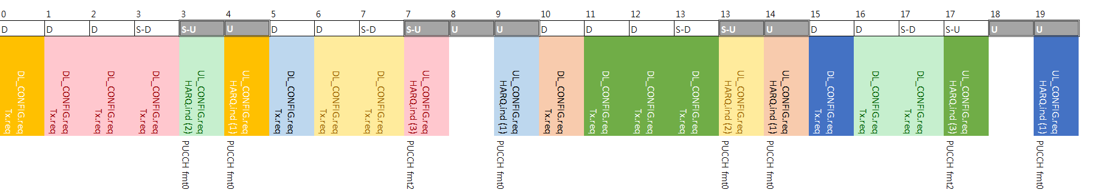
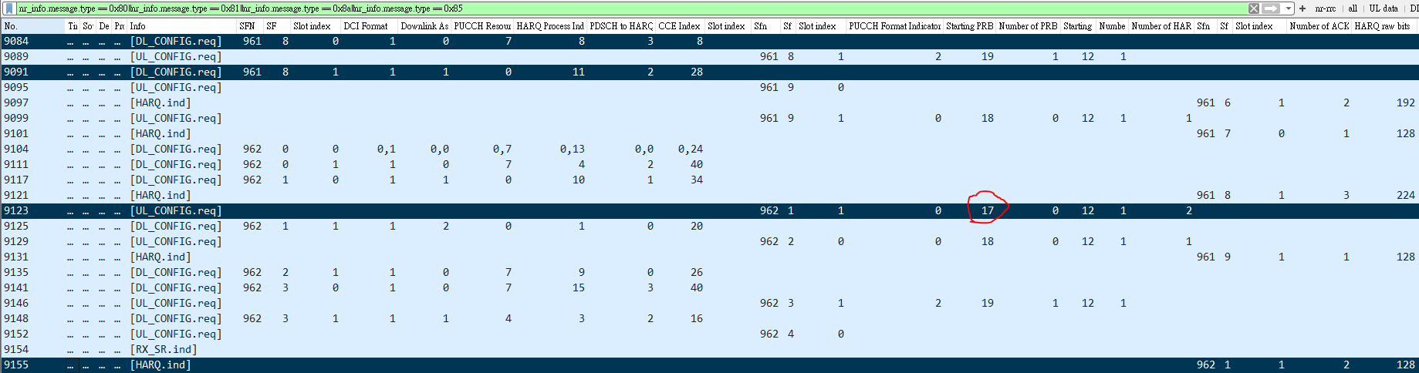
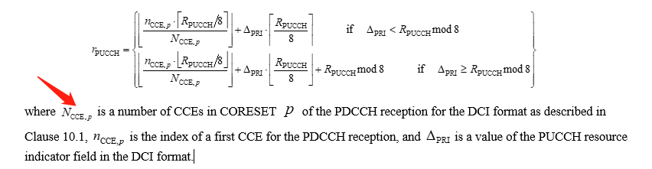
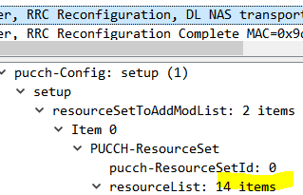
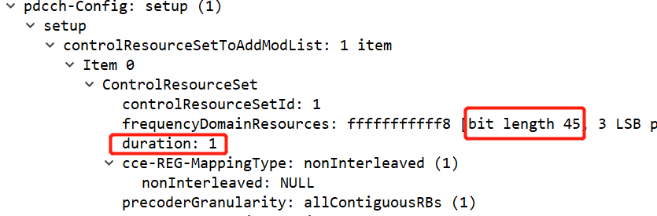
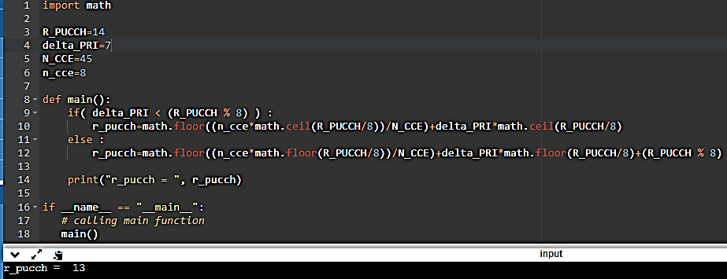
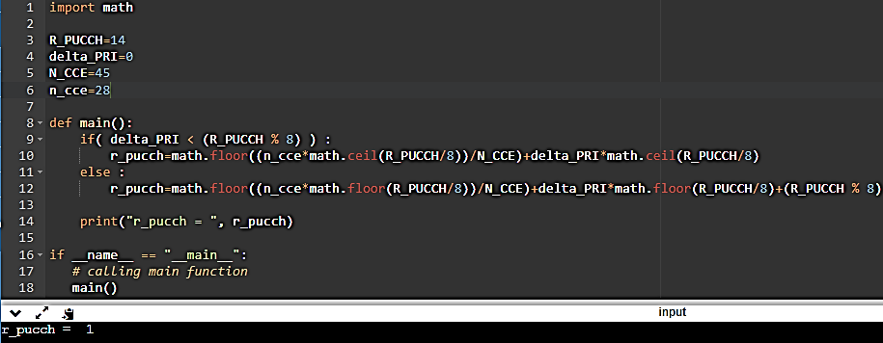
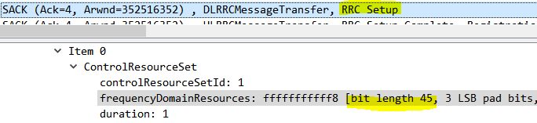
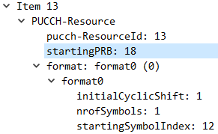
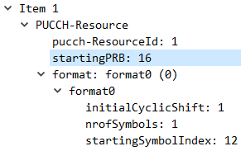
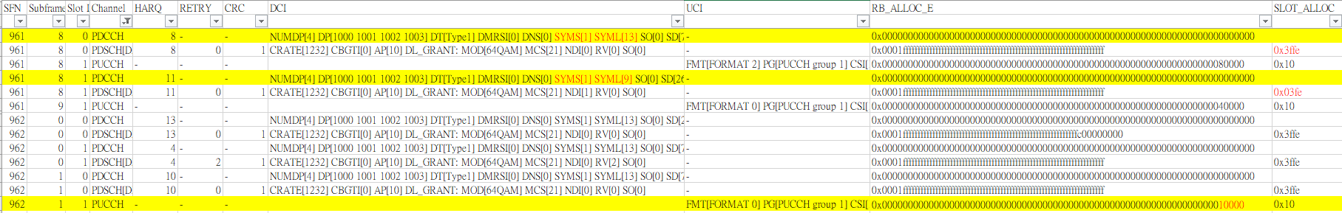
有個DCI_1_1參數PUCCH resource indicator, 當PUCCH resource set 0超過8個時, UE真實使用的PUCCH resource id必須以此為參數計算, 即TS 38.213, 9.2.3所提
Ncce is total num of CCE in the Coreset, which in your case =45
Slot 16
計算18
計算16
Slot 17
NW bbuiolog [UL_CONFIG.req] Starting PRB=17
Slot 3
UE Viavi RB_ALLOC_E=16
Notes:
0x10000 = 00010000000000000000
0x40000 = 01000000000000000000
0x80000 = 10000000000000000000
import math
R_PUCCH=14
delta_PRI=7
N_CCE=45
n_cce=8
def main():
if( delta_PRI < (R_PUCCH % 8) ) :
r_pucch=math.floor((n_cce*math.ceil(R_PUCCH/8))/N_CCE)+delta_PRI*math.ceil(R_PUCCH/8)
else :
r_pucch=math.floor((n_cce*math.floor(R_PUCCH/8))/N_CCE)+delta_PRI*math.floor(R_PUCCH/8)+(R_PUCCH % 8)
print("r_pucch = ", r_pucch)
if __name__ == "__main__":
# calling main function
main()

Slide 6
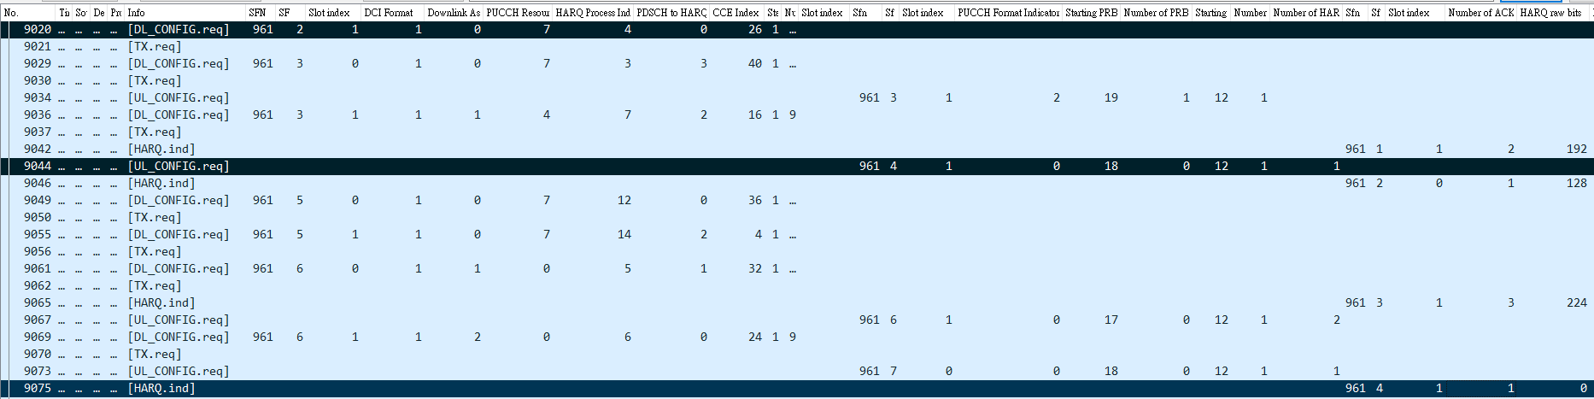
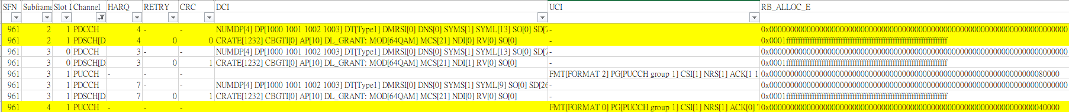
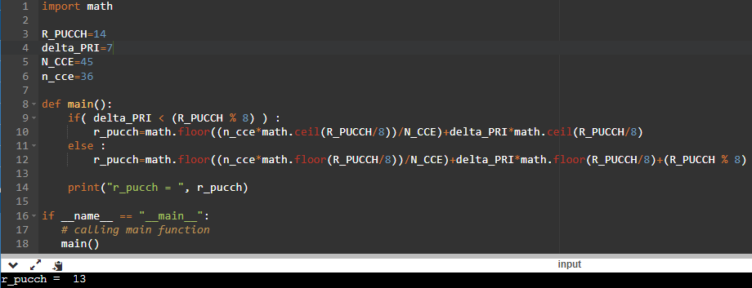
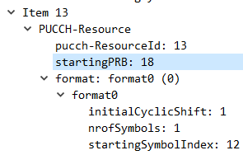
計算18
NW bbuiolog [UL_CONFIG.req] Starting PRB=18
UE Viavi RB_ALLOC_E=18
Notes:
01000000000000000000

Slide 7
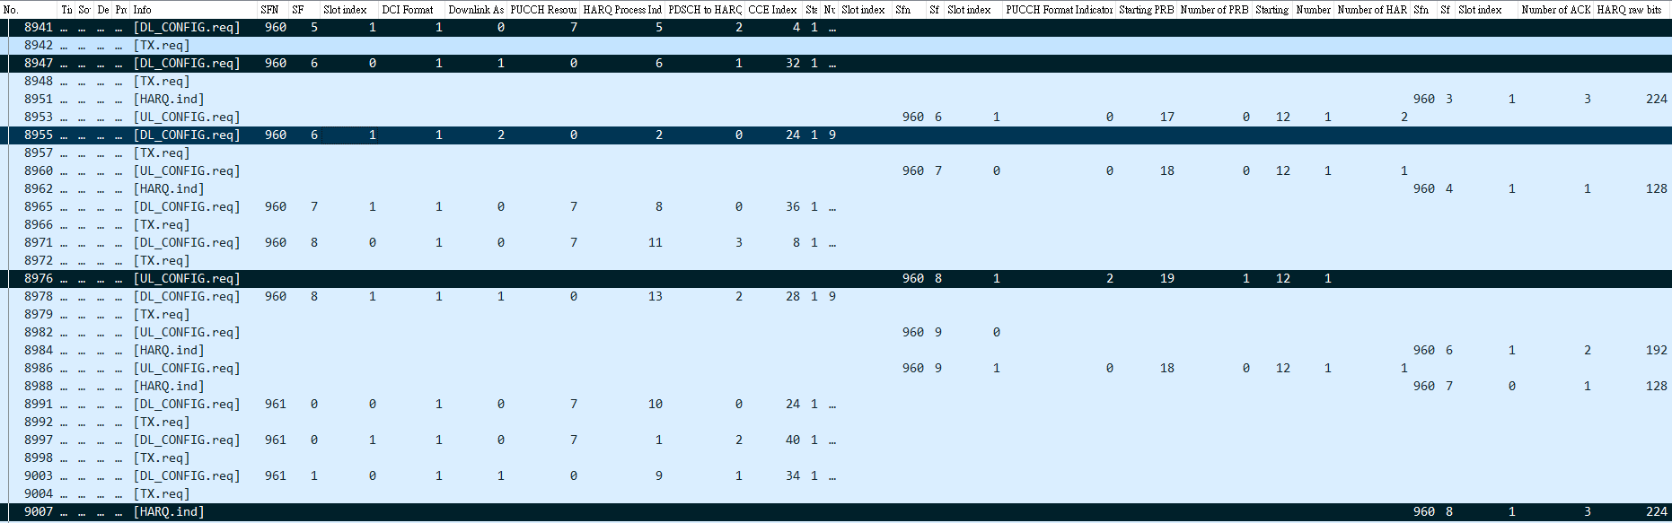

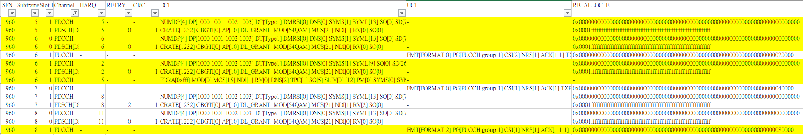
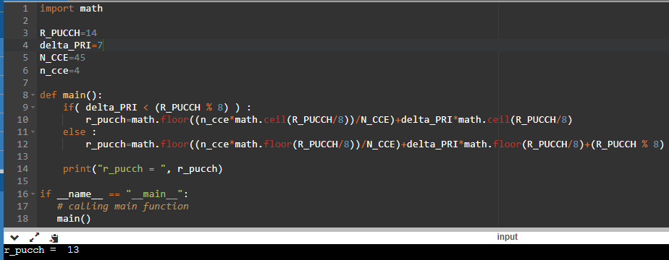
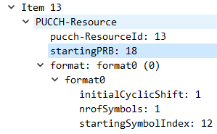
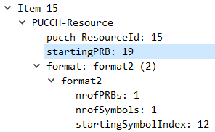
計算13
計算1
計算1
Format2是直接mapping，0就對第1個
NW bbuiolog [UL_CONFIG.req] Starting PRB=19
UE Viavi RB_ALLOC_E=19
1000 0000 0000 0000 0000

Slide 8
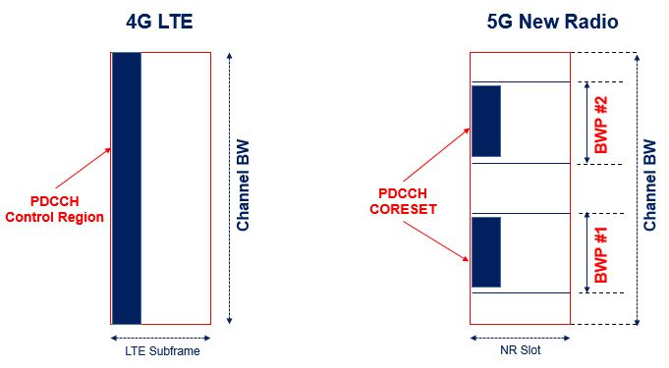
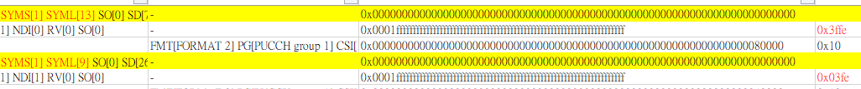
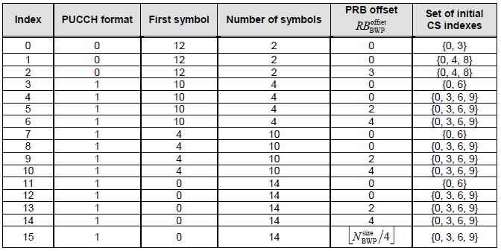


setup: 2 items
Item 0
PDSCH-TimeDomainResourceAllocation
k0: 0
mappingType: typeA (0)
startSymbolAndLength: 40 //sliv40: S=1,L=13
Item 1
PDSCH-TimeDomainResourceAllocation
k0: 0
mappingType: typeA (0)
startSymbolAndLength: 96 //sliv96: S=1,L=9
Old PUCCH format1 | New PUCCH format0
<pucchResourceCmn>3</pucchResourceCmn> <f1SymLength>4</f1SymLength> <cfgSrWithF1>1</cfgSrWithF1> | <pucchResourceCmn>0</pucchResourceCmn> <f0f2SymLength>1</f0f2SymLength> <cfgSrWithF1>0</cfgSrWithF1>

Slide 9
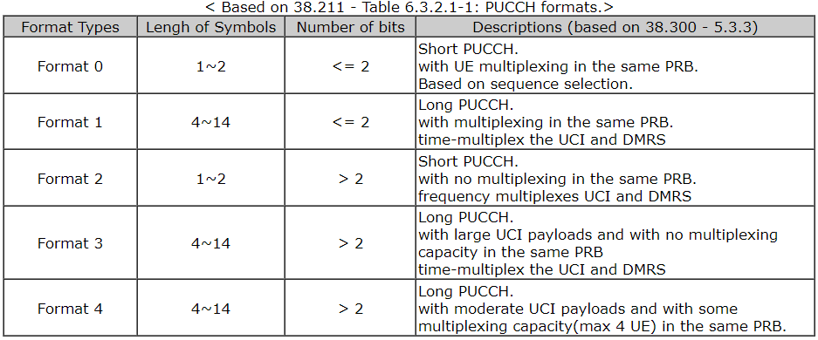
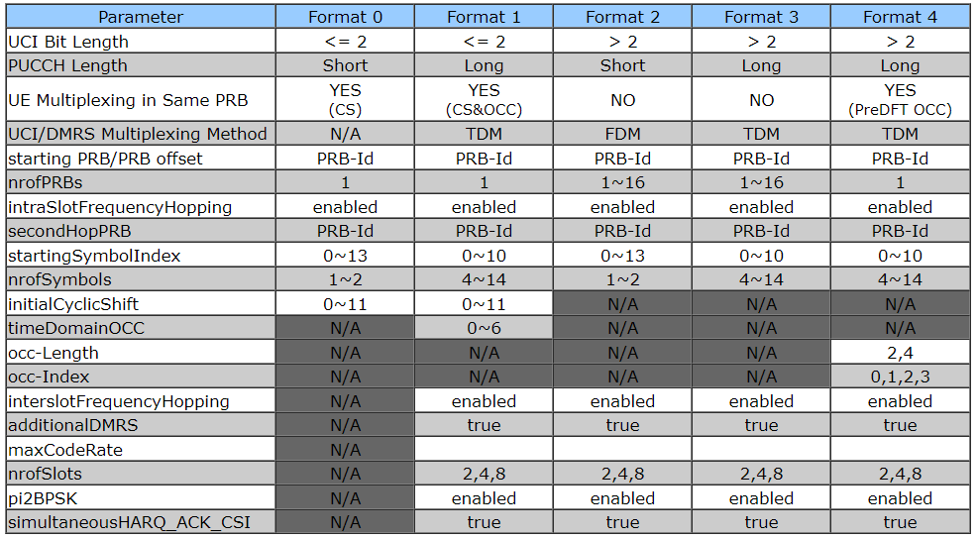
PUCCH Format 0

Slide 10
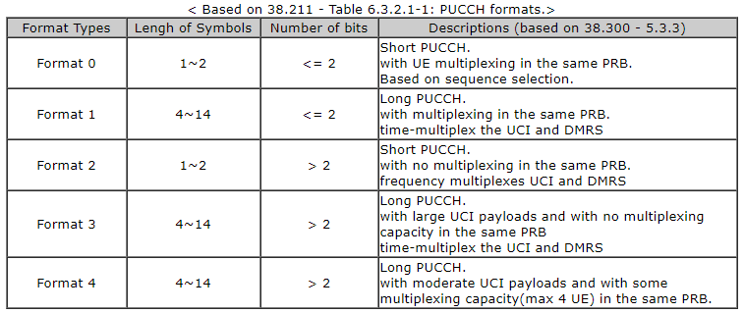

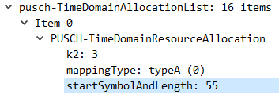
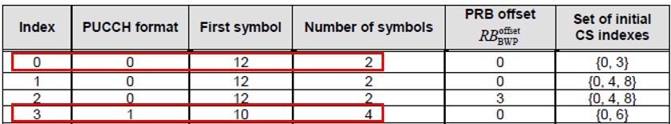
Purpose
 | 0 | 1 | 2 | 3 | 4 | 5 | 6 | 7 | 8 | 9 | 10 | 11 | 12 | 13
Format 1 |  |  |  |  |  |  |  |  |  | Pucch format 1 |  |  |  | srs
- pusch | Sliv=55, Start = 0, L=#symbols = 12
Format 0 - pucch |  |  |  |  |  |  |  |  |  |  |  |  | Fmt 0 | srs
- pusch | Sliv=55, Start = 0, L=#symbols = 12
Fixed UL – Tcp issue.
Allocated PUCCH and PUSCH resource are No overlap.
Pucch fmt 1 with 4 symbols, from 9 – 12 and PUSCH SLIV 55, start 0 to 11 and length 12
Pucch fmt 0 with 1 symbols, at 12th symbol, and PUSCH start 0 to 11.
Fixed 2 bug to support PUCCH format 0.
<pucchResourceCmn>3</pucchResourceCmn>
<f1SymLength>4</f1SymLength>
<cfgSrWithF1>1</cfgSrWithF1> //format1
 | 0 | 1 | 2 | 3 | 4 | 5 | 6 | 7 | 8 | 9 | 10 | 11 | 12 | 13
PUCCH
PUSCH
<pucchResourceCmn>0</pucchResourceCmn>
<f0f2SymLength>1</f0f2SymLength>
<cfgSrWithF1>0</cfgSrWithF1> //format0
 | 0 | 1 | 2 | 3 | 4 | 5 | 6 | 7 | 8 | 9 | 10 | 11 | 12 | 13
PUCCH |  |  |  |  |  |  |  |  |  |  |  |  | f0
PUSCH
S=6/4/4 | D | D | D | D | D | D | G | G | G | G | U | U | U | U
S=10:4:0 | D | D | D | D | D | D | D | D | D | D | G | G | G | G
S=10:2:2 | D | D | D | D | D | D | D | D | D | D | G | G | U | U
 | 0 | 1 | 2 | 3 | 4 | 5 | 6 | 7 | 8 | 9 | 10 | 11 | 12 | 13
PDCCH
PDSCH
S=6/4/4 | D | D | D | D | D | D | G | G | G | G | U | U | U | U
S=10:4:0 | D | D | D | D | D | D | D | D | D | D | G | G | G | G
S=10:2:2 | D | D | D | D | D | D | D | D | D | D | G | G | U | U

Slide 11
Test Resutls
計算網址 https://www.sqimway.com/rb_calc.php
UL-MCS | SLIV | UL-TCP | UL-UDP (err %) | DL-TCP | DL-UDP (err %) | Memo with PUCCH Format 0
17 | 83 | 51.4 M | 51.6 M (0.1%) | 16.1 M | 841M (11%) | PUCCH Format 0, cfgSrWithF1=0, pucchResourceCmn=0, Pusch length = 10
25 | 83 | 96.5 M | 51.4 M (0.1%) | 20.7 M | 852M (9.6%)
25 | 69 | 109 M | 51.8 M (0.1%) | 18.8 M | 852M (9.1%) | PUCCH Format 0, Pusch length = 11
25 | 97 | 84.1 M | 51.4 M (0.1%) | 14.4 M | 850M (9.1%) | PUCCH Format 1, cfgSrWithF1=1, pucchResourceCmn = 3, Pusch length = 9
25 | 97 | 78 M | 51.4 M (0.1%) | 14.1 M | 844M (11%) | PUCCH Format 1, Pusch length = 9, featureBit =3, maxRlcSduQSize = 2000, 200, 400,
25 | Xx 55?? | 739k | 51.8 M (0.1%) | 5.3 M | 855M (10%) | PUCCH Format 1, cfgSrWithF1=1, pucchResourceCmn = 3, Pusch length = 9, with fixMCS bin (original)
25 | 55 (no fixed) | 121 M | 51.2 M (0.1% | 68M | 860M (9.7%) | PUCCH Format 0, pucch symlength = 1,
startSymbolAndLength

Slide 12
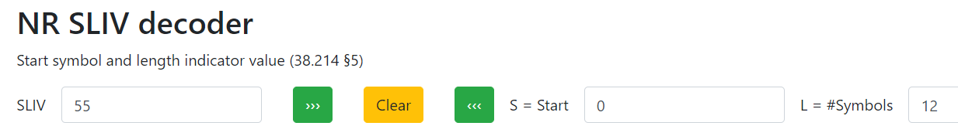
PUCCH Format 0 – DU xml setting
Old PUCCH format1 | New PUCCH format0
<pucchResourceCmn>3</pucchResourceCmn> <f1SymLength>4</f1SymLength> <cfgSrWithF1>1</cfgSrWithF1> //format1 | <pucchResourceCmn>0</pucchResourceCmn> <f0f2SymLength>1</f0f2SymLength> <cfgSrWithF1>0</cfgSrWithF1> //format0
PUSCH-TimeDomainResourceAllocation
k2: 3
mappingType: typeA (0)
startSymbolAndLength: 55

Slide 13
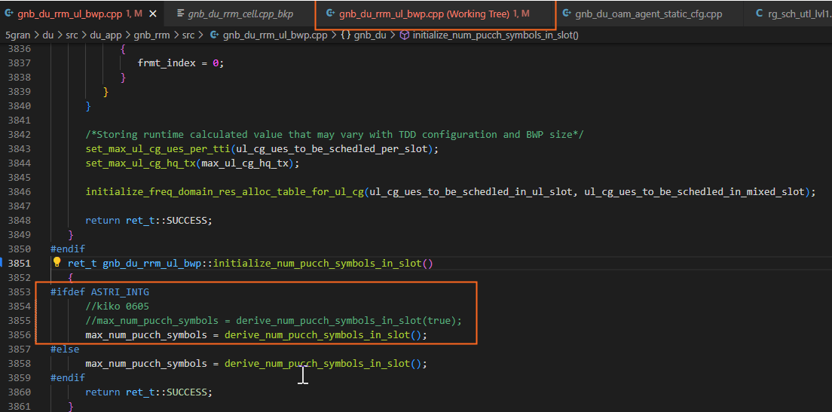
Radisys bug for PUCCH Format 0 - i
ret_t gnb_du_rrm_ul_bwp::initialize_num_pucch_symbols_in_slot()
{
#ifdef ASTRI_INTG
//kiko 0605
//max_num_pucch_symbols = derive_num_pucch_symbols_in_slot(true);
max_num_pucch_symbols = derive_num_pucch_symbols_in_slot();
#else
max_num_pucch_symbols = derive_num_pucch_symbols_in_slot();
#endif
return ret_t::SUCCESS;

Slide 14
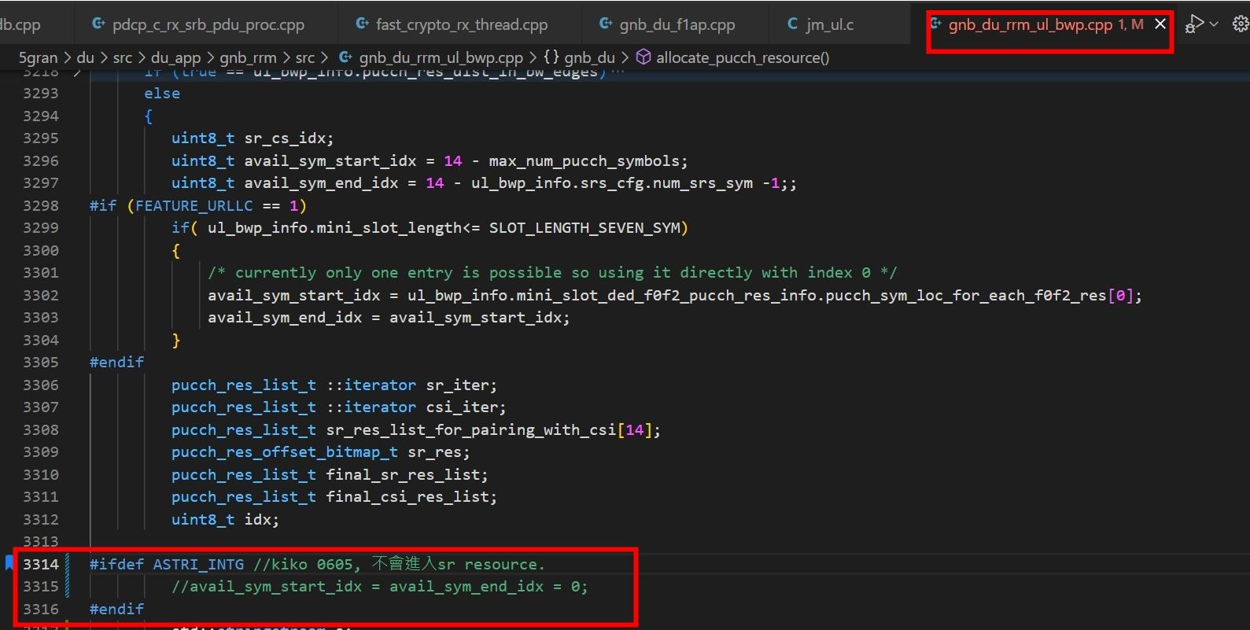
Radisys bug for PUCCH Format 0 - ii
#ifdef ASTRI_INTG //kiko 0605, 不會進入sr resource.
//avail_sym_start_idx = avail_sym_end_idx = 0;
#endif

